Slide 1


Big Data Seminar – BIA 678
Data Stream Management
David Belanger PhD
Senior Research Fellow – Stevens Institute of Technology
dbelange@stevens.edu

Slide 2
Class 7 Outline
Administrative Stuff:
Think about team projects – abstract in next week.
Poster Session – April 30.
NJBDA - April 5
Term Paper due this week.
Next couple of weeks
Assignment #1 – Next Week’s Readings
Data Stream Mining, A Survey Gupta, Rajput, http:citeseerx.ist.psu.edu/viewdoc/download?doi=10.1.1.415.1674&rep=rep1&type=pdf
Questions on Team Project Abstracts
Assignment #2 – Two Week’s Readings
A Survey of Collaborative Filtering Techniques : Su & Khoshgoftaar: on canvas
Ethics: 2018 ACM Code of Ethics and Professional Conduct: Draft 2. http://ethics.acm.org
Activity #1
Questions on DBMS Topics
Data Streaming

Slide 3
A Couple of Additional Sources
Comparison of some open source stream processing engines with code examples:
https://blog.scottlogic.com/2018/07/06/comparing-streaming-frameworks-pt1.html
Examples of Spark Performance Enhancements:
https://blog.scottlogic.com/2018/03/22/apache-spark-performance.html
Case Study: BP

Slide 4
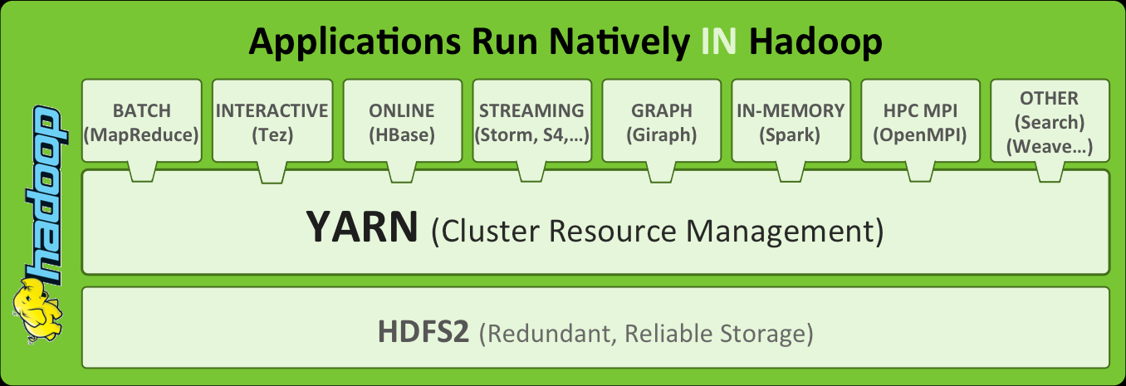
One Approach to Parallelization and Distribution
Map/Reduce – Introduced by Google in 2004
Hadoop – A top tier Apache Project
Apache Hadoop 2 – Open Source http://blog.andreamostosi.name/

Slide 5
Example (IP Networking)
Sources of Streams: Streams of IP Packets and/or Sessions
Communication: For network routers
Event based messages:
Packet Headers:
Applications:
Security
Performance
…

Slide 6
The Stanford Data Streams Research Project
Profs. Rajeev Motwani & Jennifer Widom
And a cast of full- and part-time students:
Arvind Arasu, Brian Babcock, Shivnath Babu,
Mayur Datar, Gurmeet Manku, Liadan O’Callaghan, Justin Rosentein, Qi Sun, Rohit Varma
stanfordstreamdatamanager

Slide 7
Data Streams
Traditional DBMS -- data stored in finite, persistent data sets
New applications -- data as multiple, continuous, rapid, time-varying data streams
Network monitoring and traffic engineering
Security applications
Telecom call records
Financial applications
Web logs and click-streams
Sensor networks
Manufacturing processes

Slide 8
Challenges
Multiple, continuous, rapid, time-varying streams of data
Queries may be continuous (not just one-time)
Evaluated continuously as stream data arrives
Answer updated over time
Queries may be complex
Beyond element-at-a-time processing
Beyond stream-at-a-time processing

Slide 9
Using Traditional Database
User/Application
Query
Result
Query
…
Result
…
Loader

Slide 10
New Approach for Data Streams
User/Application
Register Query
Result
Stream Query
Processor

Slide 11
New Approach for Data Streams
User/Application
Register Query
Result
Data
Stream
Management
System
(DSMS)
Stream Query
Processor
Scratch Space
(Memory and/or Disk)

Slide 12
DBMS versus DSMS
Persistent relations
One-time queries
Random access
Access plan determined by query processor and physical DB design
“Unbounded” disk store
Transient streams (and persistent relations)
Continuous queries
Sequential access
Unpredictable data arrival and characteristics
Bounded main memory

Slide 13
Sample Applications
Network management and traffic engineering (e.g., Sprint)
Streams of measurements and packet traces
Queries: detect anomalies, adjust routing
Telecom call data (e.g., AT&T)
Streams of call records
Queries: fraud detection, customer call patterns, billing

Slide 14
Sample Applications (cont’d)
Network security (e.g., iPolicy, NetForensics/Cisco, Netscreen)
Network packet streams, user session information
Queries: URL filtering, detecting intrusions & DOS attacks & viruses
Financial applications (e.g., Traderbot)
Streams of trading data, stock tickers, news feeds
Queries: arbitrage opportunities, analytics, patterns

Slide 15
Sample Applications (cont’d)
Web tracking and personalization (e.g., Yahoo, Google, Akamai)
Clickstreams, user query streams, log records
Queries: monitoring, analysis, personalization
Truly massive databases (e.g., Astronomy Archives)
Stream the data by once (or over and over)
Queries do the best they can

Slide 16
Making Things Concrete
Database = two streams of mobile call records
Outgoing(connectionID, caller, start, end)
Incoming(connectionID, callee, start, end)
Query language = SQL
FROM clauses can refer to streams and/or relations

Slide 17
Query Example 1
Find all outgoing calls longer than 2 minutes (relational selection)
SELECT O.connectionID, O.caller
FROM Outgoing O
WHERE O.end – O.start > 2
Result requires unbounded storage
Can provide result as data stream

Slide 18
Query Example 2
Pair up callers and callees (relational join)
SELECT O.caller, I.callee
FROM Outgoing O, Incoming I
WHERE O.connectionID = I.connectionID
Can still provide result as data stream
Requires unbounded temporary storage (without additional assumptions)

Slide 19
Query Example 3
Find total connection time for each caller (relational grouping and aggregation)
SELECT O.caller, sum(O.end – O.start)
FROM Outgoing O
GROUP BY O.caller
Cannot provide result in (append-only) stream

Slide 20
Data Model
Database: relations + data streams
Stream characteristics
Type of data (schema)
Data distribution
Flow rate
Stability of distribution and flow
Ordering and other constraints
Synchronization of multiple streams
Distributed streams

Slide 21
Data Stream Queries -- Basic Issues
Answer availability
One-time
Multiple-time
Continuous (“standing”), stored or streamed
Registration time
Predefined
Ad-hoc
Stream access
Arbitrary
Sliding window (special case: size = 1)

Slide 22
Query Language & Semantics
Specifying queries over streams
SQL-like versus dataflow network of operators
Sliding windows as first-class query construct
Semantic issues
Blocking operators, e.g., aggregation, order-by
Streams as sets versus lists
Timestamping

Slide 23
Query Evaluation -- Approximation
Why approximate?
Streams are coming too fast
Exact answer requires unbounded storage or significant computational resources
Ad hoc queries reference history
Issues in approximation
Sliding windows, sampling, synopses, …
How is approximation controlled?
How is it understood by user?
Accuracy-efficiency-storage tradeoff

Slide 24
Query Evaluation -- Adaptivity
Why adaptivity?
Queries are long-running
Fluctuating stream arrival & data characteristics
Evolving query loads
Issues in adaptivity
Adaptive resource allocation (memory, computation)
Adaptive query execution plans

Slide 25
Query Evaluation -- Multiple Queries
Possibly large number of continuous queries
Long-running
Shared resources
Multi-query optimization

Slide 26
Query Evaluation -- Distributed Streams
Many physical streams but one logical stream
E.g., maintain top 100 visited pages at Yahoo
Correlate streams at distributed servers
E.g., network monitoring
Many streams controlled by a few servers
E.g., sensor networks
Issues
Move processing to streams, not streams to processor
Approximation-bandwidth tradeoff

Slide 27
Query Processing Architecture
Synopses
Query Plans
Output
Stream
Applications
register
continuous queries
Running Op
X
π
Ready Op
Waiting Op
σ
σ
X
Users
issue
continuous and
ad-hoc queries
Input
Data Streams
Administrator can
monitor query execution
and adjust run-time parameters
Notes:
Make query plans bigger
Applications register CQs
Users ask CQs and ad-hoc queries
Admin monitors cq exec, memory alloc, and approx ..
Streams have to be redrawn
Disk as a high latency high capacity cache
Draw clearly:
Synopses? Show as memory being used by an operator
Queue

Slide 28
Data Stream Management Systems (DSMS) - Introduction, Concepts and Issues -
Morten Lindeberg
University of Oslo
(With slides from Vera Goebel)

Slide 29
The DSMS Research Field
New and active research field (~ 10 years) derived from the database community
Stream algorithms
Application and database perspective (we)
Two syllabus articles:
Brian Babcock, Shivnath Babu, Mayur Datar, Rajeev Motwani, Jennifer Widom: "Models and issues in data stream systems"
Lukasz Golab, M. Tamer Ozsu: "Issues in data stream management”
Future: Complex Event Processing (CEP)
Morten Lindeberg: University of Oslo

Slide 30
DBMS vs. DSMS #1
SQL Query
Result
Continuous Query (CQ)
Result
Query Processing
Query Processing
Main Memory
Main Memory
Data Stream(s)
Data Stream(s)
Disk

Slide 31
DBMS vs. DSMS #2
Traditional DBMS:
stored sets of relatively static records with no pre-defined notion of time
good for applications that require persistent data storage and complex querying
DSMS:
support on-line analysis of rapidly changing data streams
data stream: real-time, continuous, ordered (implicitly by arrival time or explicitly by timestamp) sequence of items, too large to store entirely, not ending
continuous queries

Slide 32
DBMS vs. DSMS #3
DBMS
Persistent relations (relatively static, stored)
One-time queries
Random access
“Unbounded” disk store
Only current state matters
No real-time services
Relatively low update rate (no longer true)
Data at any granularity
Assume precise data
Access plan determined by query processor, physical DB design
DSMS
Transient streams (on-line analysis)
Continuous queries (CQs)
Sequential access
Bounded main memory
Historical data is important
Real-time requirements
Possibly multi-GB arrival rate
Data at fine granularity
Data stale/imprecise
Unpredictable/variable data arrival and characteristics
Often fed by “collector” systems
Adapted from [Motawani: PODS tutorial]

Slide 33
Data Streams - Terms
A data stream is a (potentially unbounded) sequence of tuples
Each tuple consist of a set of attributes, similar to a row in database table
Transactional data streams: log interactions between entities
Credit card: purchases by consumers from merchants
Telecommunications: phone calls by callers to dialed parties
Web: accesses by clients of resources at servers
Measurement data streams: monitor evolution of entity states
Sensor networks: physical phenomena, road traffic
IP network: traffic at router interfaces
Earth climate: temperature, moisture at weather stations

Slide 34
Motivation #1
Massive data sets:
Huge numbers of users, e.g.,
Large Carrier phone events: ~ 10B events/day
Large Carrier IP backbone: ~ 30Petabytes/day packets roughly 500 bytes/packet on average
Highly detailed measurements, e.g.,
NOAA: satellite-based measurements of earth geodetics
Huge number of measurement points, e.g.,
Sensor networks with huge number of sensors

Slide 35
Motivation #2
Near real-time analysis
ISP: controlling service levels
NOAA: tornado detection using weather radar
Hospital: Patient monitoring
Traditional data feeds
Simple queries (e.g., value lookup) needed in real-time
Complex queries (e.g., trend analyses) performed off-line

Slide 36
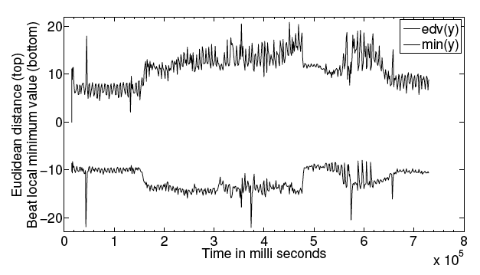
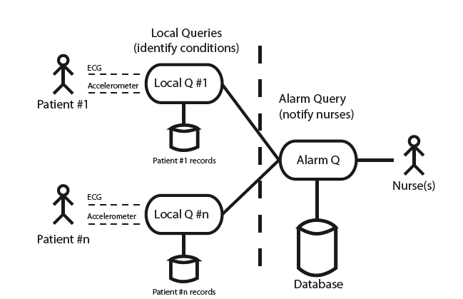
Motivation #3
Stig Støa, Morten Lindeberg and Vera Goebel. Online Analysis of Myocardial Ischemia From Medical Sensor Data Streams with Esper, to appear 2008/2009
Queries over sensor traces from surgical procedures on pigs performed at IVS, Rikshospitalet, running a open source java system called Esper
Successful identification of occlusion to the heart (heart attack)
Heart attack!
SELECT y, timestamp
FROM Accelerometer.win:ext_timed(t, 5 s)
HAVING count(y) BETWEEN 2 AND 200

Slide 37
Requirements
Data model and query semantics: order- and time-based operations
Selection
Nested aggregation
Multiplexing and demultiplexing
Frequent item queries
Joins
Windowed queries
Query processing:
Streaming query plans must use non-blocking operators
Only single-pass algorithms over data streams
Data reduction: approximate summary structures
Synopses, digests => no exact answers
Real-time reactions for monitoring applications => active mechanisms
Long-running queries: variable system conditions
Scalability: shared execution of many continuous queries, monitoring multiple streams

Slide 38
Data Models
Real-time data stream: sequence of items that arrive in some order and may only be seen once.
Stream items: like relational tuples
Relation-based: e.g., STREAM, TelegraphCQ and Gigascope
Object-based: e.g., COUGAR, Tribecca
Window models
Direction of movements of the endpoints: fixed window, sliding window, landmark window
Time-based vs. Tuple-based
Update interval: eager (for each new arriving), lazy (batch processing), non-overlapping tumbling windows.

Slide 39
More on Windows
Mechanism for extracting a finite relation from an infinite stream
Solves blocking operator problem
Sliding:
window
Jumping:
window
window
window
window
window
Overlapping
window
window
window
window
window
window
window
(adapted from Jarle Søberg)

Slide 40
Timestamps
Used for tuple ordering and by the DSMS for defining window sizes (time-based)
Useful for the user to know when the the tuple originated
Explicit: set by the source of data
Implicit: set by DSMS, when it has arrived
Ordering is an issue
Distributed systems: no exact notion of time

Slide 41
Queries #1
DBMS: one-time (transient) queries
DSMS: continuous (persistent) queries
Unbounded memory requirements
Blocking operators: window techniques
Queries referencing past data

Slide 42
Query Languages #1
Stream query language issues (compositionality, windows)
SQL-like proposals suitably extended for a stream environment:
Composable SQL operators
Queries reference relations or streams
Queries produce relations or streams
Query operators (selection/projection, join, aggregation)
Examples:
GSQL (Gigascope)
CQL (STREAM)

Slide 43
Query Languages #2
3 querying paradigms for streaming data:
Relation-based: SQL-like syntax and enhanced support for windows and ordering, e.g., CQL (STREAM), StreaQuel (TelegraphCQ), AQuery, GigaScope
Object-based: object-oriented stream modeling, classify stream elements according to type hierarchy, e.g., Tribeca, or model the sources as ADTs, e.g., COUGAR
Procedural: users specify the data flow, e.g., Borealis, users construct query plans via a graphical interface
(1) and (2) are declarative query languages, currently, the relation-based paradigm is mostly used.

Slide 44
Sample Stream
Traffic ( sourceIP -- source IP address sourcePort -- port number on source
destIP -- destination IP address
destPort -- port number on destination
length -- length in bytes
time -- time stamp
);

Slide 45
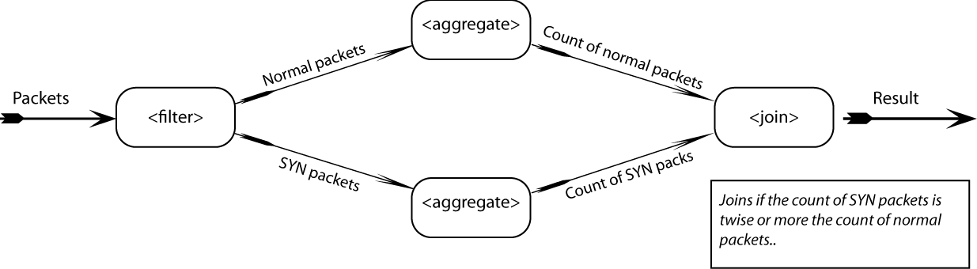
Procedural Query (Borealis)
Simple DoS (SYN Flooding) identification query

Slide 46
Selections and Projections
Selections, (duplicate preserving) projections are straightforward
Local, per-element operators
Duplicate eliminating projection is like grouping
Projection needs to include ordering attribute
No restriction for position ordered streams
SELECT sourceIP, time
FROM Traffic
WHERE length > 512

Slide 47
Joins
General case of join operators problematic on streams
May need to join arbitrarily far apart stream tuples
Equijoin on stream ordering attributes is tractable
Majority of work focuses on joins between streams with windows specified on each stream
SELECT A.sourceIP, B.sourceIP
FROM Traffic1 A [window T1], Traffic2 B [window T2]
WHERE A.destIP = B.destIP

Slide 48
Data Reduction Techniques
Aggregation: approximations e.g., mean or median
Load Shedding: drop random tuples
Sampling: only consider samples from the stream (e.g., random selection). Used in sensor networks.
Sketches: summaries of stream that occupy small amount of memory, e.g., randomized sketching
Wavelets: hierchical decomposition
Histograms: approximate frequency of element values in stream

Slide 49
Stream Processing Engines Examples
Apache Spark
Apache Storm
Apache Flink
IBM InfoStreams
(Many More)

Slide 50
Stream Processing Engines Types
Declarative:
Chain Functions Together
System Optimizes DAG
E.g. Spark, Flink
Compositional:
Developer Defines the DAG
E.g. Storm

Slide 51
Stream Processing Engines Examples
Apache Spark
Apache Storm
Apache Flink
IBM InfoStreams
(Many More)

Slide 52
Twitter/Apache Storm
Guaranteed data processing
Horizontal scalability
Fault-tolerance
No intermediate message brokers!
Higher level abstraction than message passing
“Just works”
Hadoop of real time streaming jobs
Built by Backtype, recently bought by Twitter
Available as Open source

Slide 53
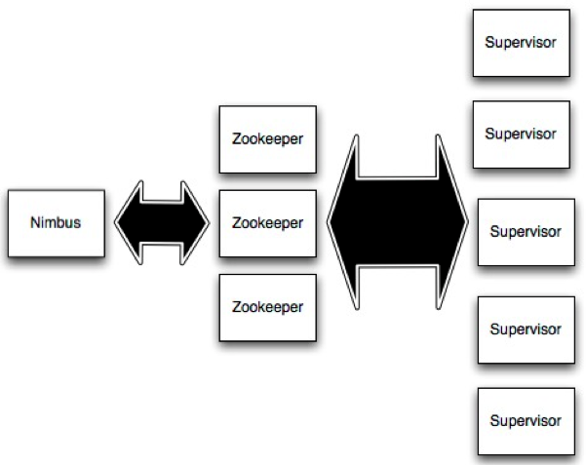
Storm
Master Node
Cluster Coordination
Worker processes

Slide 54
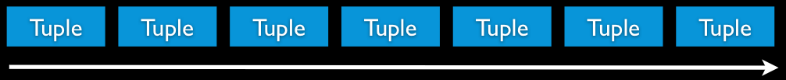
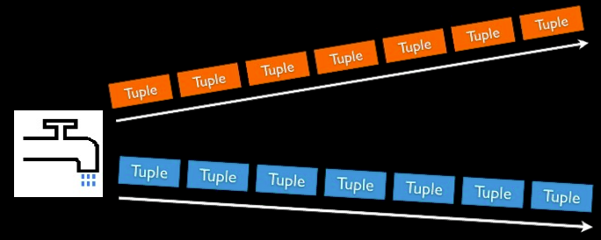
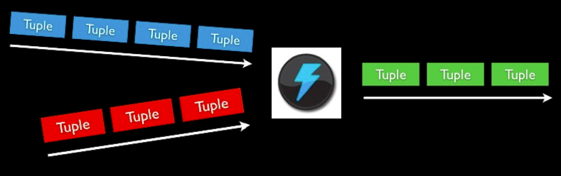
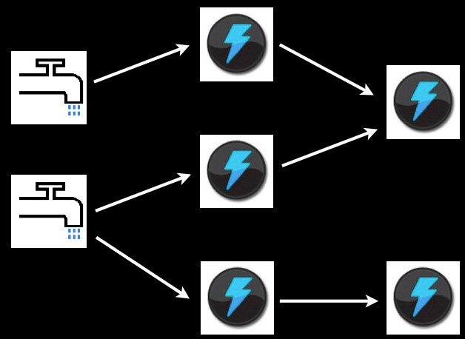
Storm Concepts
Streams
Unbounded sequence of tuples
Spout
Source of Stream
E.g. Read from Twitter streaming API
Bolts
Processes input streams and produces new streams
E.g. Functions, Filters, Aggregation, Joins
Topologies
Network of spouts and bolts

Slide 55
Non-Cloud Stream Processing Engines
Academic prototypes
Aurora + Borealis (Brown/MIT/Brandeis)
Gigascope (AT&T/Carnegie Mellon)
NiagaraST (Wisconsin/Portland State)
STREAM (Stanford)
TelegraphCQ (UC Berkeley)
Commercial platforms
StreamBase
Coral8 → Sybase CEP
Oracle CEP
Microsoft StreamInsight
Truviso
IBM System S
SQLStream
…
CEP
Cayuga [Cornell]
Esper and NEsper [EsperTech]
Spatiotemporal systems
SECONDO [Hagen Univ.]
PLACE [Purdue]
Microsoft StreamInsight Spatial
Benchmarks
Linear Road [Aurora, STREAM]
NEXMark [NiagaraST]
BerlinMOD [Hagen Univ.]
Notes:
Ο κατάλογος δεν είναι εξαντλητικός

Slide 56
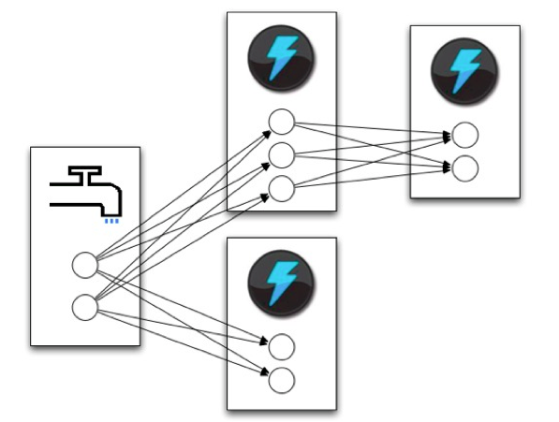
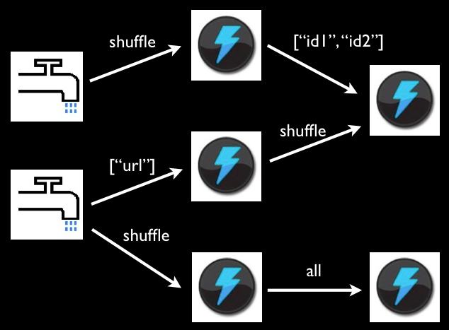
Storm Tasks
Spouts and bolts execute as many tasks across the cluster
When a tuple is emitted, which task does it go to? → User programmable:
Shuffle grouping: pick a random task
Fields grouping: consistent hashing on a subset of tuple fields
All grouping: send to all tasks
Global grouping: pick task with lowest id

Slide 57
Example: WordCount in Storm
TopologyBiulder builder = new TopologyBiulder();
biulder.setSpout(1, new KernelSpout(“kestrel.twitter.com”,
22133, “sentence_queue”, new StringScheme()),5);
builder.setBolt(2, new SplitSentence(), 8).shuffleGrouping(1);
builder.setBolt(3, new WordCount(), 12)
.fieldGrouping(2, new Fields(“word”));
//===============================================================
Public static class SplitSentence extends ShellBolt implements IRichBolt {
//Code to split a sentence
}
Public static class WordCount implements IBasicBolt{
//Code to count words, have to override the execute function
Public void execute(Tuple tuple, BasicOutputCollector collector){
//…
}
}
//================================================================
StormSubmitter.submitTopology(“word-count”, builder.createTopology);
Parallelism Degree
(Number of tasks for a spout or Bolt)

Slide 58
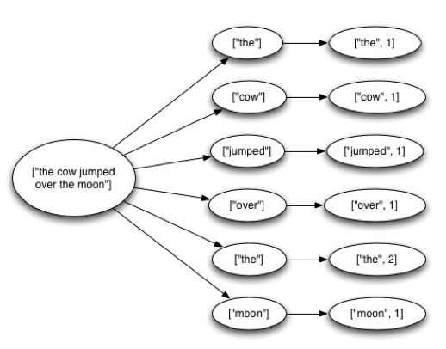
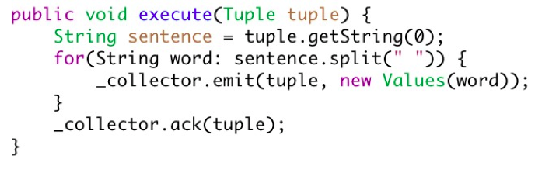
Guaranteeing Message Processing
Tuple Tree →
A spout tuple is not fully processed until all tuples in the tree have been completed
If the tuple tree is not completed within a specified timeout, the spout tuple is replayed
Reliability API for the user:
“Anchoring” creates a new edge in the tuple tree
Marks a single node in the tree as complete

Slide 59
Storm: Under the Hood
Distributes code and configurations
Robust process management
Monitors topologies and reassigns failed tasks
Provides reliability by tracking tuple trees
Routing and partitioning of streams
Serialization
Fine-grained performance stats of topologies

Slide 60
Storm
Original Slides by
Nathan Marz
Twitter

Slide 61
What we want
Guaranteed data processing
Horizontal scalability
Fault-tolerance
No intermediate message brokers!
Higher level abstraction than message passing
“Just works” !!
Original Slides by: Nathan Marz - Twitter

Slide 62
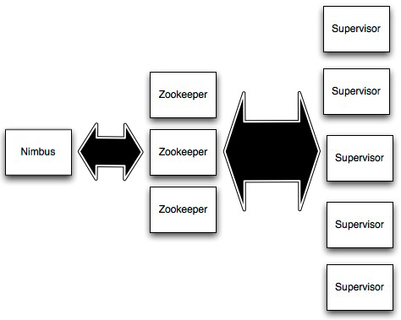
Storm Cluster
Master node (similar to
Hadoop JobTracker)
Used for cluster coordination
Run worker processes
Original Slides by: Nathan Marz - Twitter

Slide 63
Concepts
Streams
Spouts
Bolts
Topologies
Original Slides by: Nathan Marz - Twitter

Slide 64
Streams
Tuple
Tuple
Tuple
Tuple
Tuple
Tuple
Tuple
Unbounded sequence of tuples
Original Slides by: Nathan Marz - Twitter

Slide 65
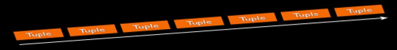
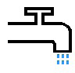
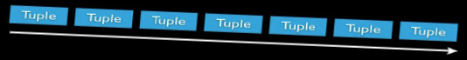
Spouts
Source of streams
Original Slides by: Nathan Marz - Twitter

Slide 66
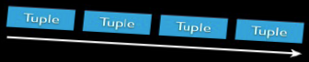

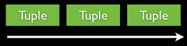
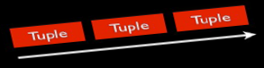
Bolts
Processes input streams and produces new streams:
Can implement functions such as filters, aggregation, join, etc
Original Slides by: Nathan Marz - Twitter

Slide 67
Topology
Network of spouts and bolts
Original Slides by: Nathan Marz - Twitter

Slide 68
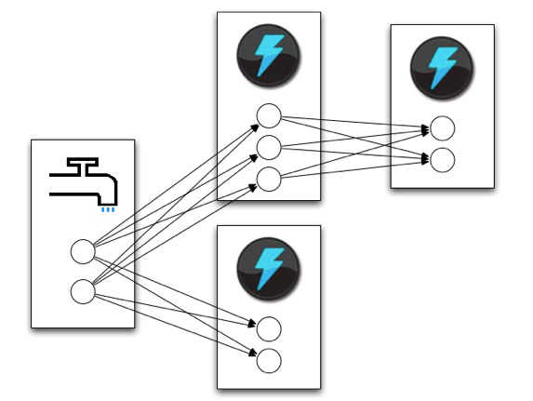
Topology
Spouts and bolts execute as
many tasks across the cluster
Original Slides by: Nathan Marz - Twitter

Slide 69
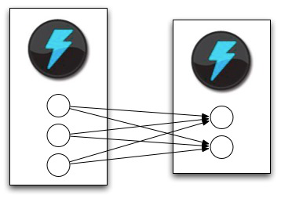
Stream Grouping
When a tuple is emitted which task does it go to?
Original Slides by: Nathan Marz - Twitter

Slide 70
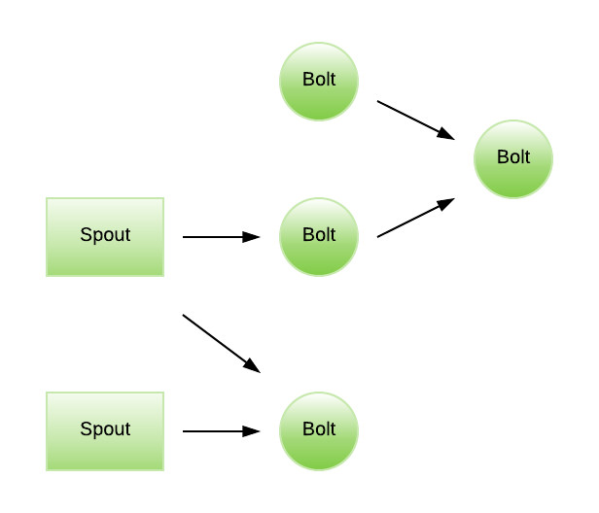
Apache Storm

Slide 71
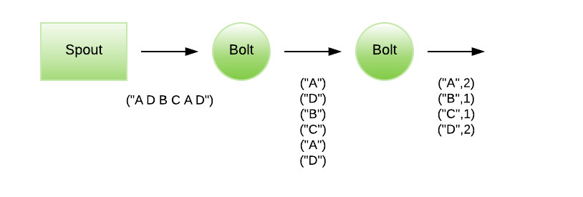
Apache Storm Word Count Example Source: https://blog.scottlogic.com/2018/07/06/comparing-streaming-frameworks-pt1.html

Slide 72
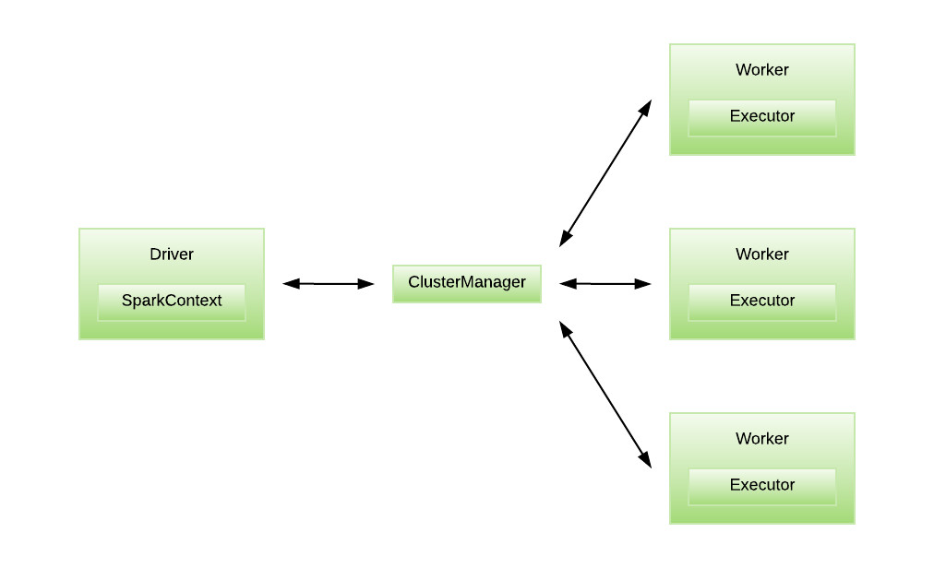
Apache Spark Streaming Declarative

Slide 73
Issues in Data Stream Management Golab/Ozsu
Data Model and Query Semantics must allow low order-based and time-based operations
Inability to store a complete stream
Streaming query plans may not use blocking operations
Backtracking over a data stream is not feasible (Single Pass)
React quickly to unusual data values (or missing values)
Long running queries may encounter changes in system conditions (and also drift in data)
Shared execution needed to ensure scalability

Slide 74
Load Shedding
When input stream rate exceeds the capacity of the system (e.g. flow, queries), the data stream manager can “shed” load
This obviously effects queries, answers, analytics, etc. – How?
There are various strategies for load shedding – e.g. random, semantic, block.

Slide 75
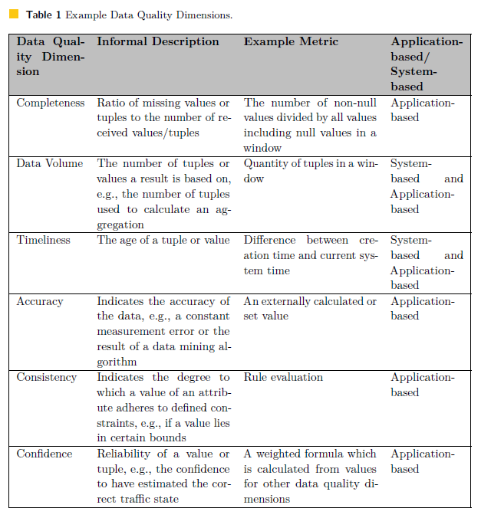
Geisler: Data Stream Management Systems

Slide 76
Stream Warehousing
Theodore Johnson
AT&T Labs - Research
johnsont@research.att.com

Slide 77
What is Stream Warehousing
• Data Stream Management System
– Fast processing in main memory
• Small data windows, 1-­‐pass processing
– Data reduction and alerting
• Data Warehouse
– Long­‐term data storage
– Curated data sets
– Fuse data from many sources
– Derived data products, complex analytics
• Data Stream Warehouse
– A data warehouse with continual real-­‐time updates.
Theodore Johnson AT&T Labs - Research

Slide 78
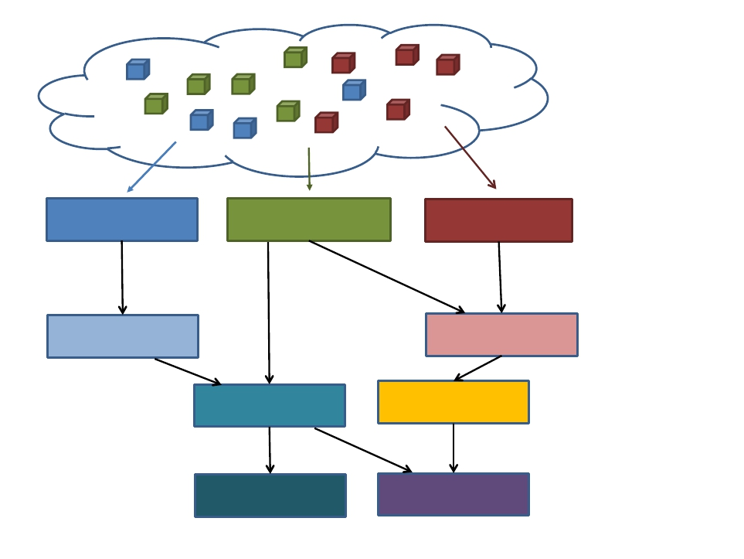
Data Feeds
Base Tables
Derived Data
Tables
Theodore Johnson AT&T Labs - Research

Slide 79
Application: Darkstar
• AT&T Labs – Research project.
• Collect diverse and large-­‐scale data feeds from network
elements
• Use for
– networking research,
– data mining (e.g. correlate network events with failures),
– alerting,
– troubleshooting
• The network is a large and complex system
– Not just IPV4.
Theodore Johnson AT&T Labs - Research

Slide 80
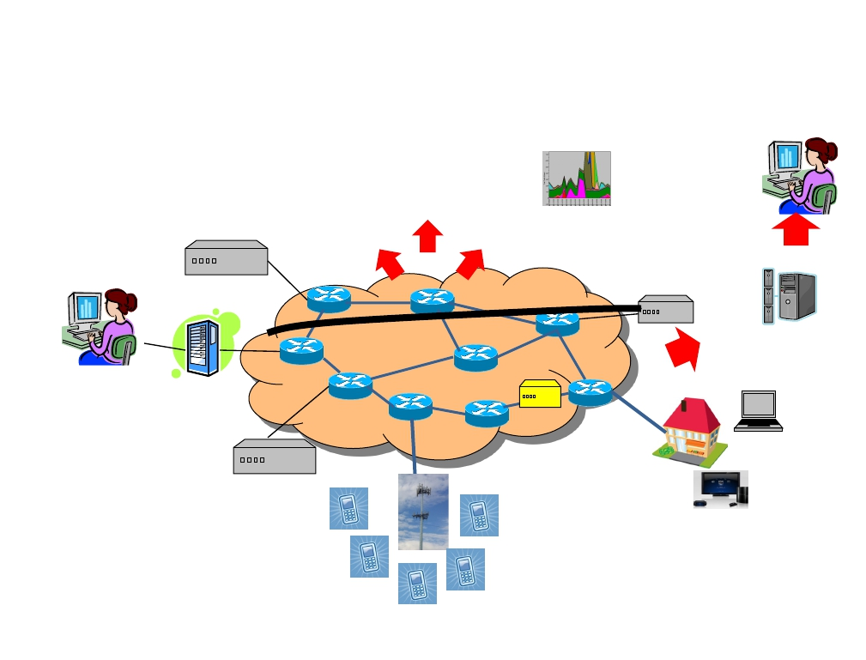
Darkstar: Mining Vast Amounts of Data
Ethernet Access
Route monitors
(OSPFmon,
BGPmon)
Conﬁg
Syslog
Tickets
SNMP Polling (router, link)
Nealow
IPTV
Network
Alarms
Deep Packet
InspecIon (DPI)
Device service
monitoring Mobility
(CIQ, MTANet, STREAM)
Customer feedback –
IVR, tickets, MTS
AuthenIcation/
logging
(tacacs)
IP Backhaul
Enterprise IP, VPNs Active
service and
connecIvity
monitoring
Theodore Johnson AT&T Labs - Research

Slide 81
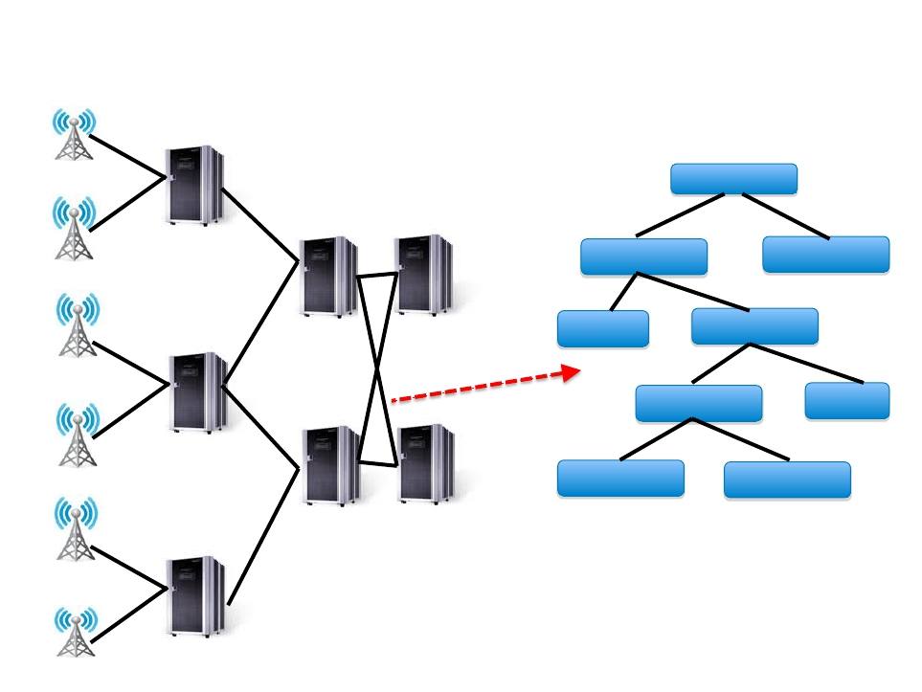
Approach: Mobility Localization Hierarchy
SITE
Market
GGSN
Data
Sub-­‐Market … ­‐Market
RNC
SITE
SITE
SGSN … SGSN
SGSN
Collect en
nd-­‐to-­‐
nce
end
Performa
RNC … RNC
RNC
…
SITE
SITE
SITE
SGSN
GGSN
SITE
SITE
RNC
Theodore Johnson AT&T Labs - Research

Slide 82
DataDepot
• Data warehousing system developed for
stream warehousing
– (Relatively) independent of the underlying
database.
• Technologies for pushing updates through a
warehouse
– Update Propagation
– Temporal consistency
– Real-­‐Time scheduling in a stream warehouse
– Lukasz Golab, Vladislav Shkapenyuk
Theodore Johnson AT&T Labs - Research

Slide 83
Many Data Feeds
• The value of a warehouse is the ability to
correlate diﬀerent streams of informaIon.
– Correlate periods of high packet loss on the active
measurement probes with the router CPU and
Memory utilization on the routers on the path
between the measurement probes.
• Diﬀerent feeds have diﬀerent time lags
– Active measurements: 45 minutes, SNMP: 15 minutes
• Darkstar
– Warehouse of network performance, conﬁguration,
and alert data
– Used for research, billing, network troubleshooting
– 100 data feeds, 700 tables as of December 2010.
Theodore Johnson AT&T Labs - Research

Slide 84
Query Stability
• How do I know when the data is stable enough to
query?
• What is stable enough?
– Data will never change
– Data won’t change much.
– I’ll take whatever is there.
Theodore Johnson AT&T Labs - Research

Slide 85
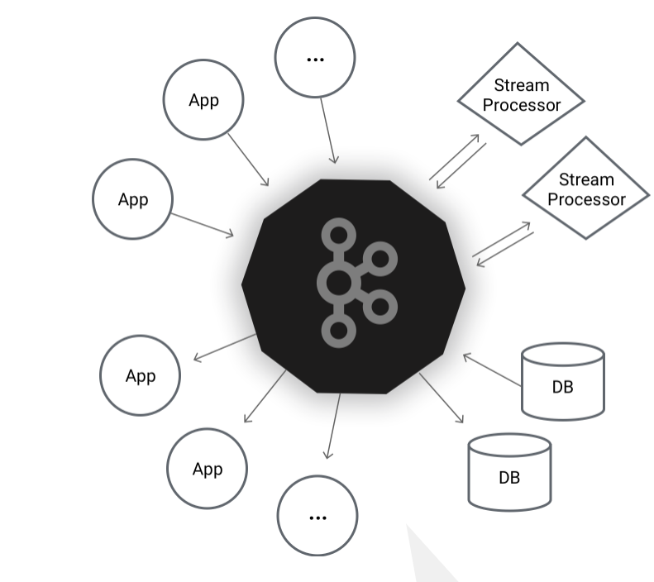
Kafka A Distributed Streaming Platform https://kafka.apache.org/intro

Slide 86
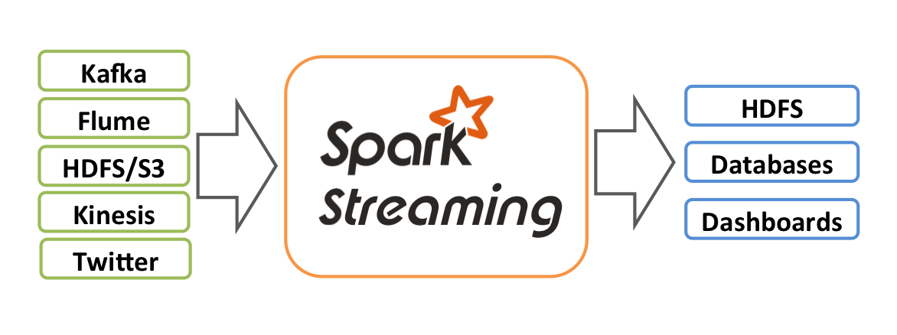
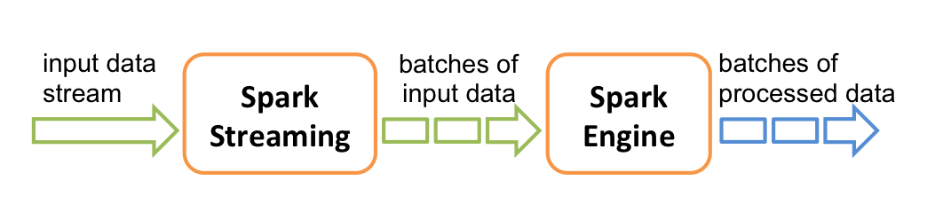
Kafka and Spark Spark Streaming Programming Guide

Slide 87
Kafka – Self View
Kafka® is used for building real-time data pipelines and streaming apps. It is horizontally scalable, fault-tolerant, wicked fast, and runs in production in thousands of companies.

Slide 88
Kafka – An Introduction From apache.kafka.org
A streaming platform has three key capabilities:
Publish and subscribe to streams of records, similar to a message queue or enterprise messaging system.
Store streams of records in a fault-tolerant durable way.
Process streams of records as they occur.

Slide 89
Kafka – An Introduction From apache.kafka.org
Applications:
Building real-time streaming data pipelines that reliably get data between systems or applications
Building real-time streaming applications that transform or react to the streams of data

Slide 90
Kafka – An Introduction Concepts From apache.kafka.org
Kafka is run as a cluster on one or more servers that can span multiple datacenters.
The Kafka cluster stores streams of records in categories called topics.
Each record consists of a key, a value, and a timestamp

Slide 91
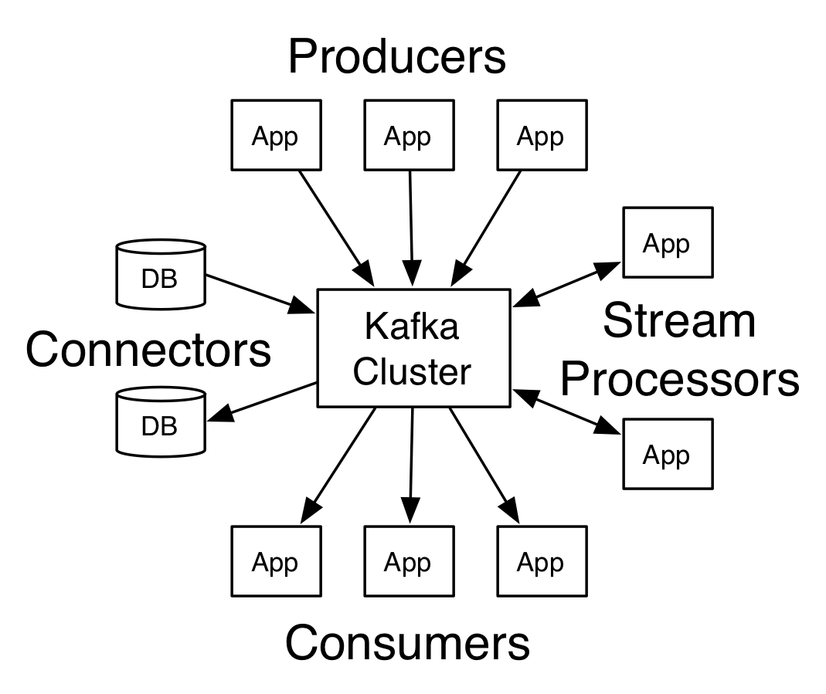
Kafka – An Introduction APIs From apache.kafka.org
APIs:
Producer
Consumer
Streams
Connector
Communication: TCP
Client Language:
Almost All Common Languages

Slide 92
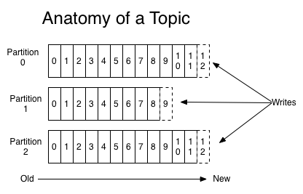
Kafka – An Introduction Topic – A Stream of Records From apache.kafka.org
Topic = Category to which records are published
Always multi-subscriber – zero, one, many
Structured, Sequential, Immutable Commit Log – with configurable retention time.

Slide 93
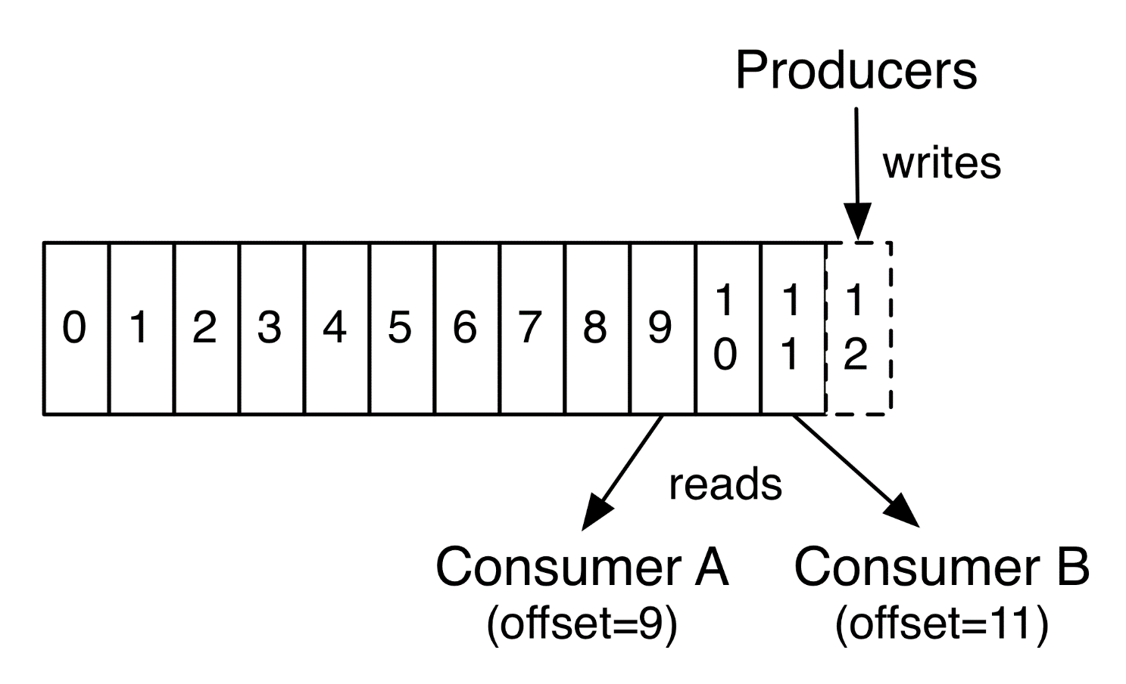
Kafka – An Introduction Producers, Consumers From apache.kafka.org

Slide 94
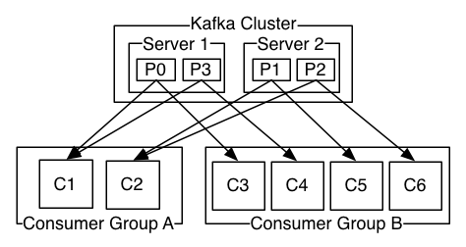
Kafka – An Introduction From apache.kafka.org
Distribution
Geo-Replication
Producer
Consumer

Slide 95
Kafka – An Introduction From apache.kafka.org
Guarantees:
Records sent by a producer preserve order
A consumer sees records in the order on the log
A topic with replication factor N, with tolerate up to N-1 server failures.
Applications:
Messaging
Storage
Streaming

Slide 96
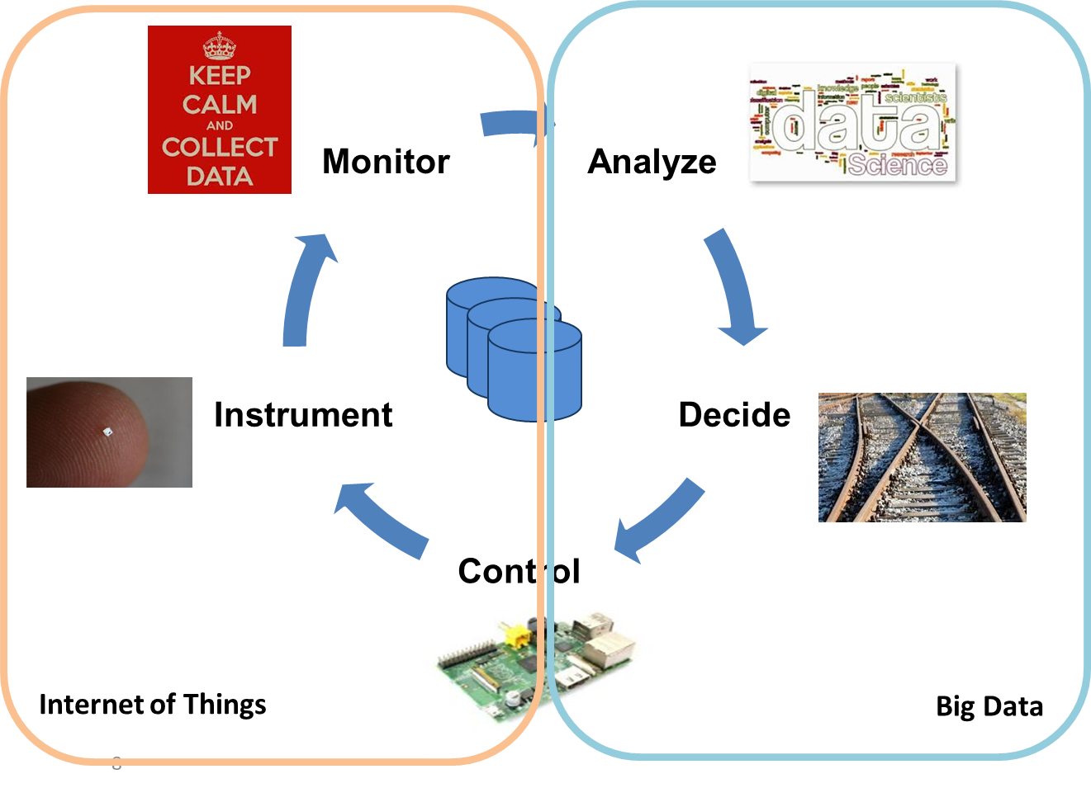
Next Week Data Stream Analytics

